Slide 1
Linear Regression & other stuff

Slide 2
01
What is Regression?

Slide 3
What is Regression?
Regression is a powerful statistical method that allows you to examine the relationship between two or more variables of interest.
While there are many types of regression analysis, at their core they all examine the influence of one or more independent variables on a dependent variable.
It primary goal is to predict or modeling relationships.

Slide 4
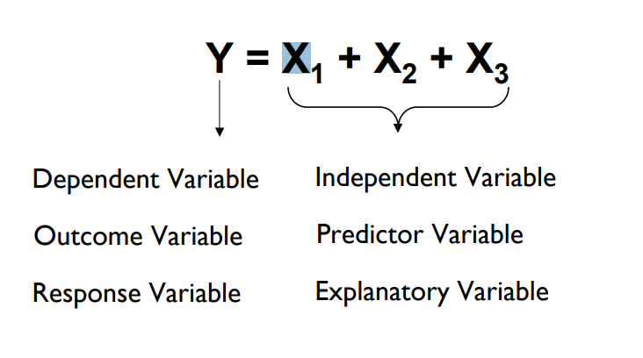
What is Regression?

Slide 5
02
Simple Linear Regression

Slide 6
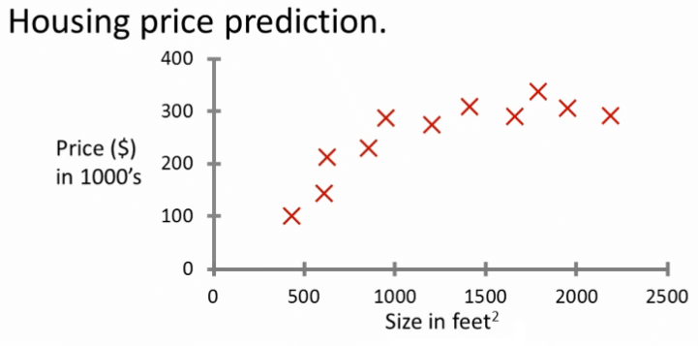
Linear Regression
Suppose we want to model the dependent variable house price in terms of the predictor house size. How will we do it?

Slide 7
Linear Regression
Linear Regression is a statistical method used to model the relationship between dependent and independent variables.
Linear Regression assumes that the best fit line for the data points is a straight line.
Its goal is to find a linear equation that best predicts the dependent variable based on the values of the independent variables(s). “Line of best fit”

Slide 8
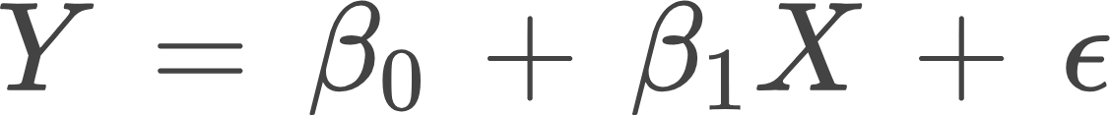
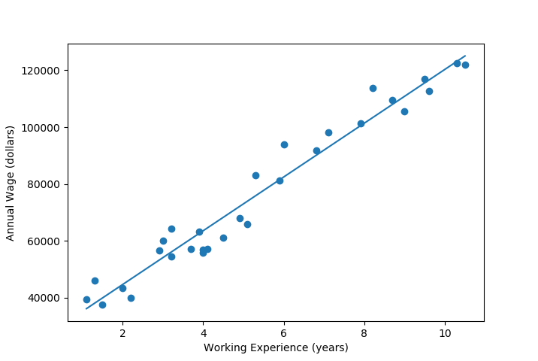
Simple Linear Regression “Single Independent Variable”
Y is the dependent variable.
X is the independent variable.
β₀ is the y-intercept (the value of Y when X is 0).
β₁ is the slope of the line (how much Y changes for a unit change in X).
ϵ is the error term, accounting for the variability in Y not explained by X. “irreducible error”

Slide 9
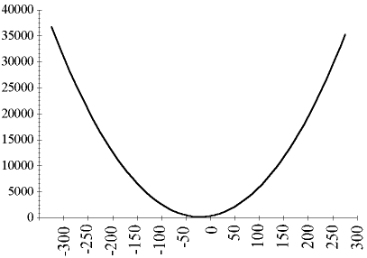
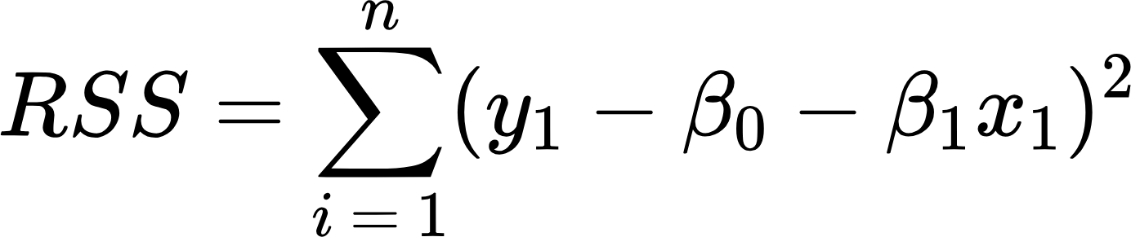
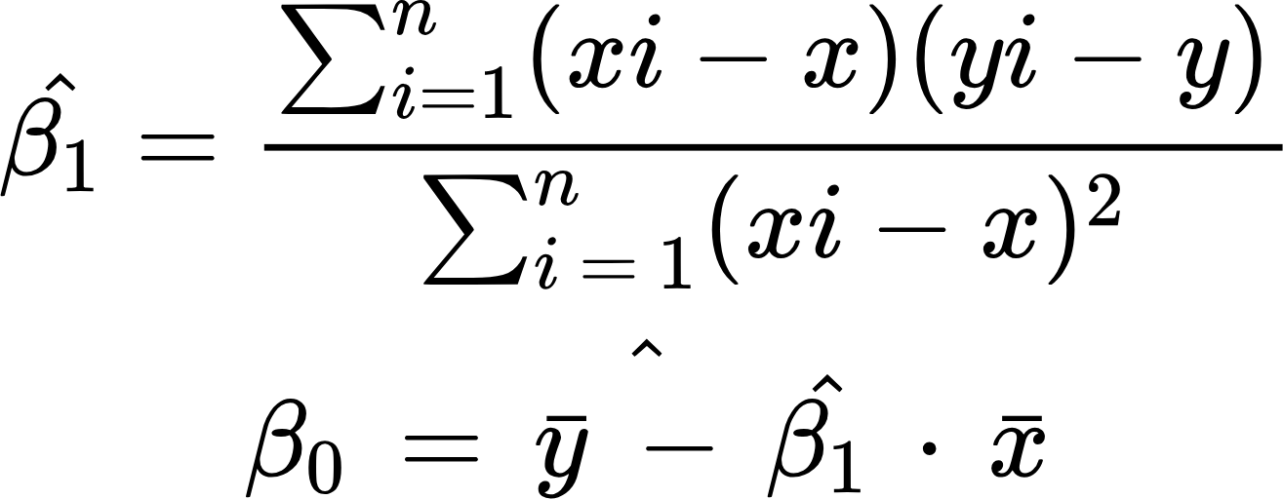
Simple Linear Regression “Single Independent Variable”
How do we estimate the coefficients/parameters? “β₀, β₁”
The Residual sum of squares gives us a measure of closeness, by minimizing it we are able to get the best possible lines.
Due to the squaring RSS is highly sensitive to large differences.
Using some calculus we can get the 2 Betas that minimize the RSS
Where y bar and x bar are the mean of y and x respectively
Note: this is a convex function like y = x²

Slide 10
03
Gradient Descent

Slide 11
Why Gradient Descent?
We have discussed an Analytic approach to get the best fitting line.
However this approach worked due to the fact our model is linear. For more complex models like neural networks this approach will not work as the model is not linear so we cannot get the minimum in one step
That is why we need an iterative approach like gradient descent.

Slide 12
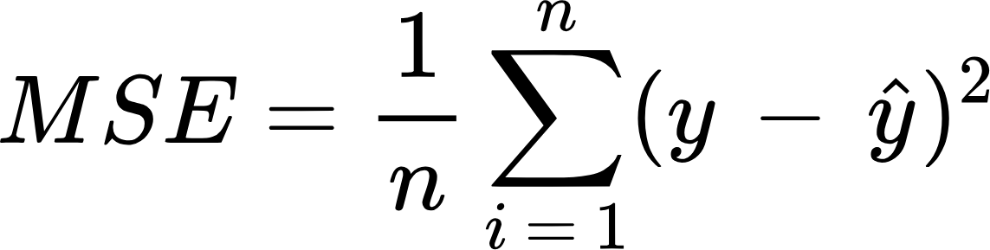
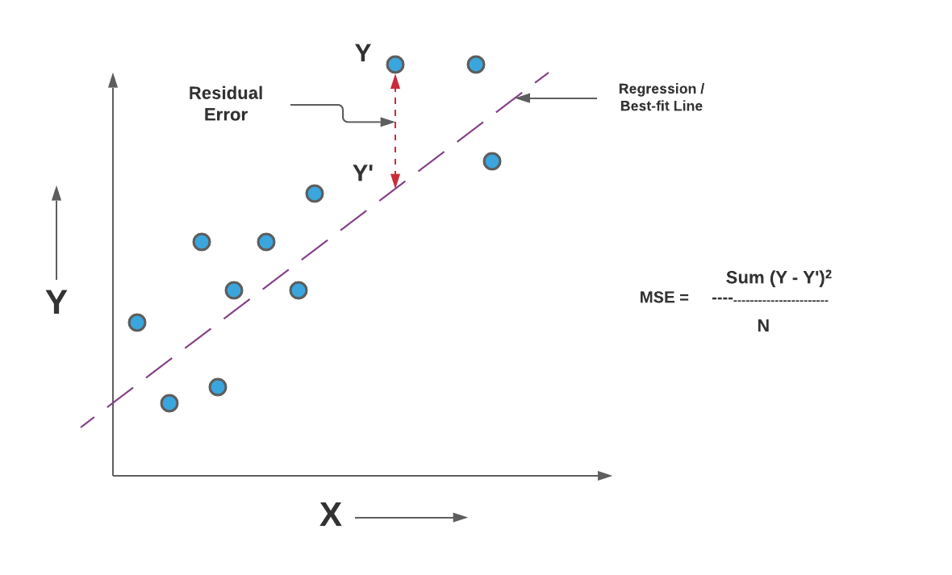
What is a loss/cost function?
It is a function that tells us how bad our model is.
The lower the cost function the better our model.
The loss function is for one individual prediction while the cost function is for the entire training set.

Slide 13
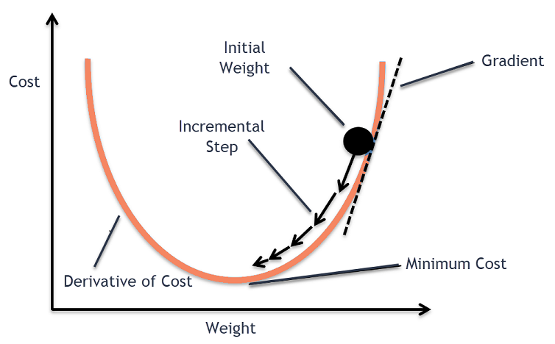
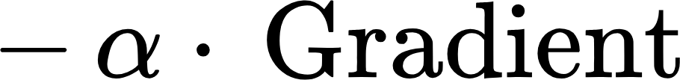
Gradient Descent
Quick recap: The gradient of a function at a point is a vector pointing in the direction of the greatest rate of increase of a function.
As we can see the cost function is a convex function which means it have 1 local minima
How does gradient descent work?
Start with random parameters
Compute the gradient
Update the parameters by:
“Alpha is the learning rate”
Go to step 2 until done or bored

Slide 14
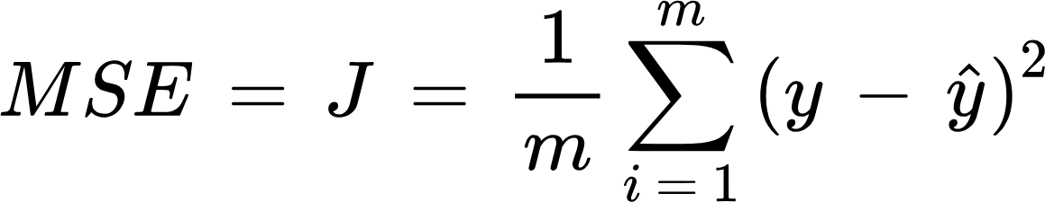
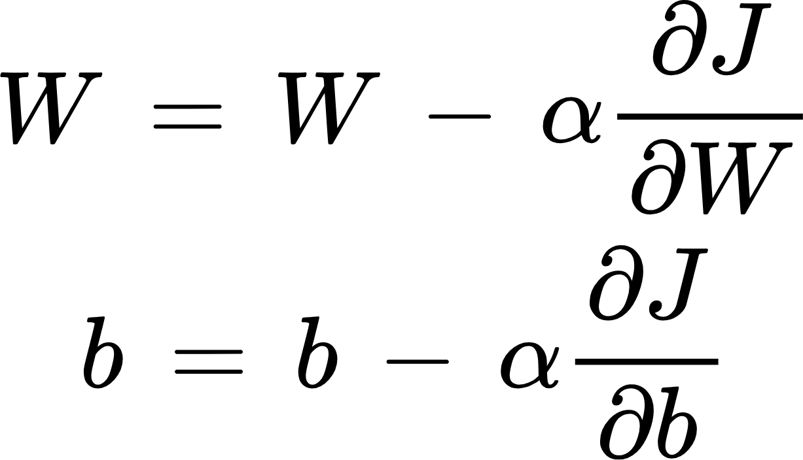
Gradient Descent
Good to know
Update rules:
0.001 for example
What is alpha?
It is the second hyperparameter we get to know
It determine the size of the step taken towards the minimum
It's a critical hyperparameter. If it's too small, the algorithm converges slowly. If it's too large, it may overshoot the minimum or diverge.

Slide 15
General framework for supervised learning
We have a model specified by some parameters
We have data
We have a function to compute how well the model fits the data (loss function)
We have an optimization method to change the parameters in a way that minimizes the loss function
Repeat until done/bored
Note: Linear regression is a special case where we can find the minimum in one go.

Slide 16
04
Multiple Linear Regression

Slide 17
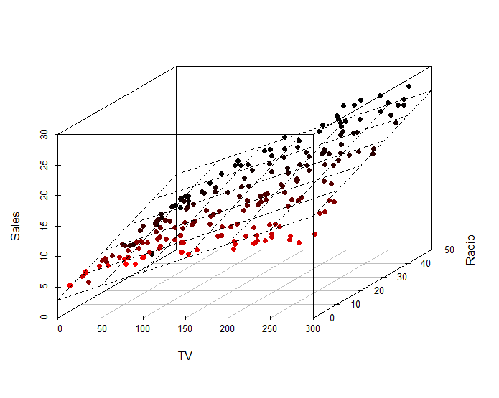
Multiple Linear Regression
It extends the simple linear regression model so that it can directly accommodate multiple independent variables. We can do this by giving each predictor a separate slope coefficient in a single model.
Same ideas of simple linear regression

Slide 18
Linear Regression
Pros:
Very simple and easy to use
Isn’t computationally expensive
Works well as a baseline/sanity check
Cons:
It’s often too simple to be useful
Can’t model non-linear data
Sensitive to outliers

Slide 19
05
Overfitting and Underfitting

Slide 20
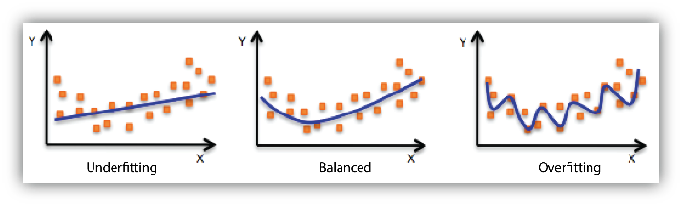
Overview of overfitting and underfitting
Assume we have the dataset in the picture below, and we can fit any polynomial of any degree to model the data, so what polynomial should we fit?
In model 1 we try to fit a straight line into non linear data
In model 2 we try to fit a more complex model into the data
In model 3 we try to fit an even more complex model into the data
Which model should we pick?

Slide 21
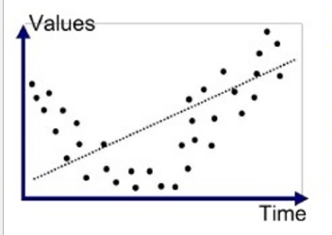
Underfitting
Model 1
Underfitting occurs when a model is too simple, failing to capture the underlying trend of the data. The model does not fit the data well enough, leading to poor performance both on the training and testing datasets.
Causes:
Oversimplified model
Insufficient features
Excessive Regularization? “more on that later”

Slide 22
Signs of Underfitting
Poor performance on both training and testing data as the model is over simplified
The model cannot capture the trends and patterns in the data.
A simple example if we are predicting house prices underfitting can occur when we predict the price on the size only without accounting to the location of the house, number of bedrooms and nearby, nearby schools, nearby hospitals, … etc

Slide 23
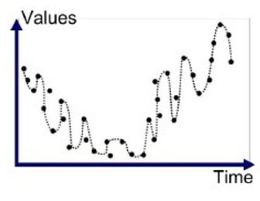
Overfitting
Model 3
Overfitting occurs when a model learns both the underlying pattern and the noise in the training data to such an extent that it negatively impacts the model's performance on new, unseen data. Essentially, the model becomes too complex, capturing patterns that do not generalize to other data sets.
Causes:
Too many features
Higher order polynomials
Lack of regularization ? “more on that later”

Slide 24
Signs of Overfitting
A model with an unusual high performance on the training data but with poor performance on the test accuracy.
Overfit models often exhibit high variance. This means that small changes in the training data can lead to large changes in the model, which is indicative of the model capturing noise in the training data.
Simple example:In a stock market prediction model, while it perfectly predicts past market trends, it fails to accurately forecast future market movements when applied to new data.

Slide 25
Sources
https://www.youtube.com/playlist?list=PLblh5JKOoLUICTaGLRoHQDuF_7q2GfuJF
https://scikit-learn.org/stable/modules/cross_validation.html
https://www.statlearning.com

Slide 26
THANK YOU!

